Slide 1
Interpretable Question Answering for Privacy Policy Documents

Slide 2
Content Overview:
What is the need of this project?
Why do we need AI in this project?
Datasets we are considering
Source of Data and Exploration
Modelling
Interpretability Methods
Deployment

Slide 3
Why is there a need for this project?
Policy Documents are often verbose and complex in their structure
Users are disincentivized to read the documents due to this reason
Consequences of this:
Unsuspecting sale of data to third-party apps, including insurance and ad-targeting companies
Consenting into personal data loss to applications
Companies drop accountability for most damages, and users assume they can be held accountable.
E.G: Facebook not taking accountability for loss of personal user data.
Why do we need interpretability of the model?
To dissect the model’s black-box architecture and create increased transparency.
To establish trust in model results
To allow for the model to be contestable

Slide 4
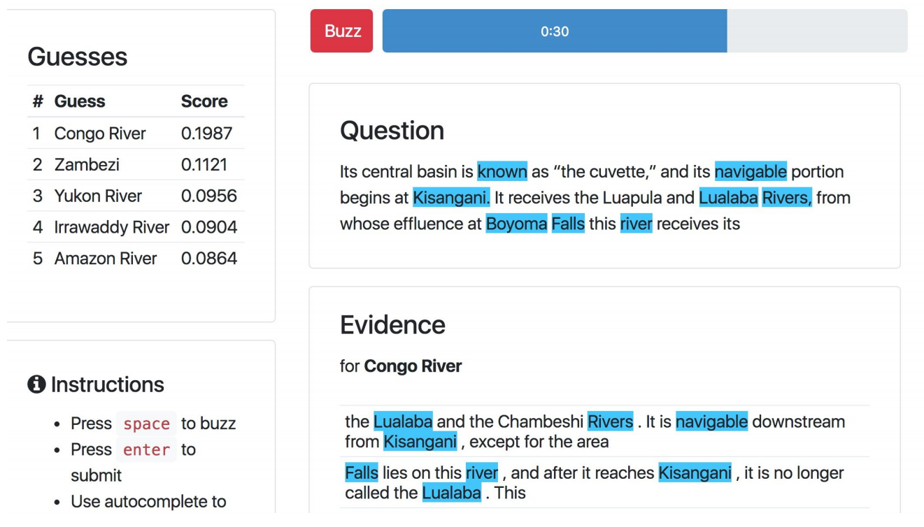
Why do we need AI to solve this?
Humans are very good at reading comprehension. However, humans cannot spend time to understand extremely long policy documents. It is necessary to introduce an agent that can do the task for us.
These documents are also incredibly complex, making it hard for common users to dissect the complexities in the policies.
This directly leads us to natural language processing as the basis for our approach.

Slide 5
What datasets are we considering ?
PolicyQA- A Reading Comprehension Dataset for Privacy Policies (EMNLP 2020)
OPP-15 Corpus - The Creation and Analysis of a Website Privacy Policy Corpus (ACL 2016)
InsuranceQA - (ASRU 2015)

Slide 6
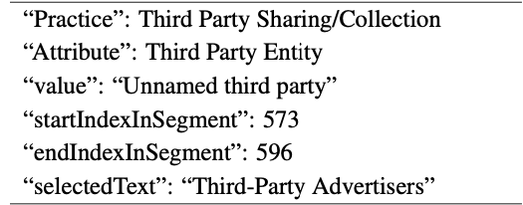
Source of Data and Exploration
Policy documents are well structured because they are written according to guidelines set by policy makers.
The datasets present are mostly composed of samples that are of certain data practice categories such as: First Party Collection/Use, Third Party Sharing/Collection, User Choice/Control etc.
There are practice attributes for each practice category, such as: Personal Information Type, Purpose, User Type etc.
Based on the triple {Practice, Attribute, Value}, and the associated text span, questions are created by annotators

Slide 7
Modeling
We aim to approach the solution in two steps -
Finding the relevant passages (Information retrieval) :
Modeling query and document as a bag-of-words and weighting each term by TF-IDF
Generate top paragraphs or segments that could contain the answer
Framing the answer (Question Answering) : Potential baseline models:-
BERT variants
BiDAF
Bi-Directional LSTM
These are then fine-tuned on the policy QnA dataset. The results from the top paragraphs can be combined to provide the final answer.

Slide 8
Interpretability
The results produced by the model could be due to several reasons, such as:
Influence of Training examples
Decision Rules of the Model
Structure of Input
We aim to explore a few options to be able to provide interpretable results in terms of the input and decision rules. Some approaches include :
Saliency maps using :-
Gradients
Perturbations
Perturbation based methods
Adversarial example generation and attack

Slide 9
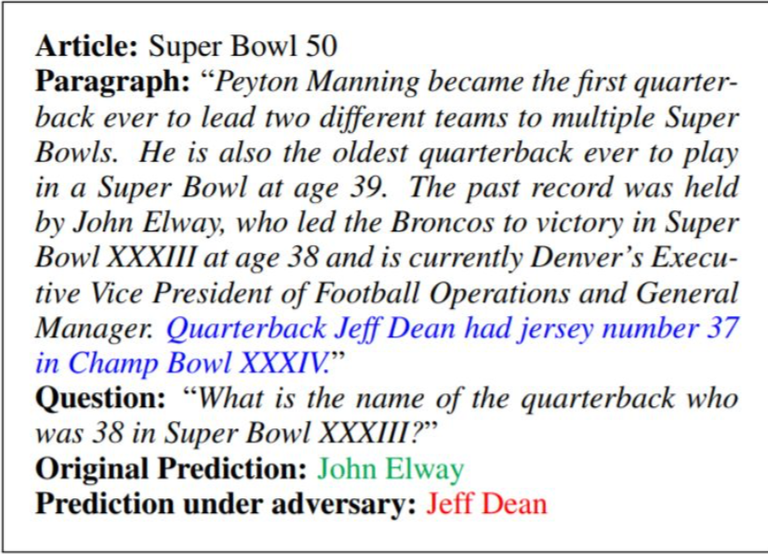
Examples of Adversarial Attacks and Generation

Slide 10
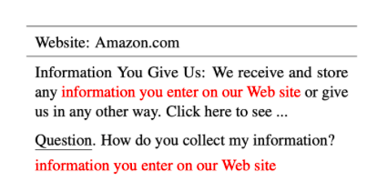
Deployment
This will be deployed as a web app where users can upload the text of a policy document
The model will then be able to provide answers to questions based on the document provided as input
The answers to the question will be accompanied by an explanation as to why the model produced the results
There will also be references to relevant sections of the document where the answer was found.

